Slide 1
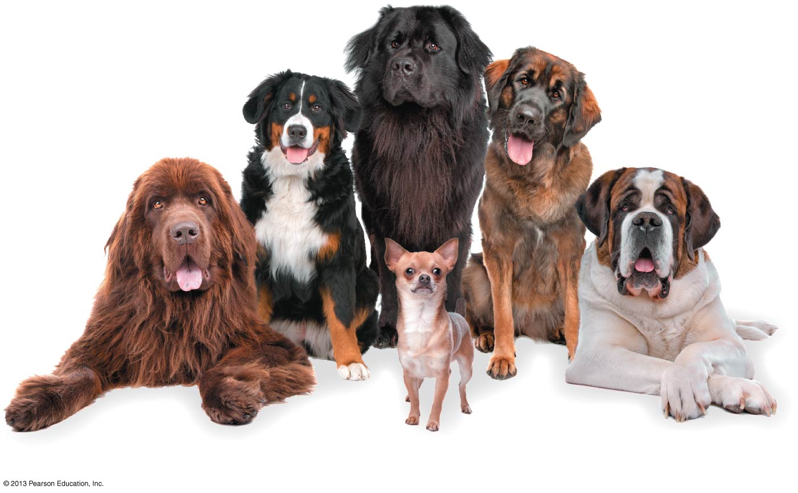
WELCOME TO GENERAL BIOLOGY !
BIO2001

Slide 2
Instructor and TAs
Instructor:
Dr. Chen Jihang 陈吉航
E-Mail: chenjihang@cuhk.edu.cn
Phone: 8427-3819
Office: Cheng Dao Bldg 501
Office hour: 10:00-11:00 am Thursday
Teaching Assistants:
TAN Xinran 谈昕然
E-Mail: tanxinran@CUHK.edu.cn
Cheng Xinyi 程馨亿
E-Mail: lixuan@CUHK.edu.cn
Zhou Youli 周有丽
E-Mail: 218019124@link.cuhk.edu.cn

Slide 3
Course Description
General Biology is a foundation course that is designed for students who may or may not have taken science courses with a biology component at the senior high school level. It presents our current understandings of cells and molecules of life, genetics and evolution, organisms（生物体）and their environment. Those students who have successfully completed this course will have a solid foundation for studying more advanced courses in life sciences.

Slide 4
Learning Outcomes
Upon completing this course, the students are expected to have the following learning outcomes:
KNOWLEDGE: Describe and integrate the important concepts, principles and knowledge in life science as covered in this course.
SKILLS: Gradually develop the basic skills that would enable them to apply the learned concepts, principles and knowledge in understanding and explaining cases and situations in real world life and scenarios.
GENERIC SKILLS AND VALUES: Think critically and creatively; independent problem-solving skills; self-learning skills; team-work (group-work) and interpersonal skills; scientific approaches and methodologies, ethics …

Slide 5
Textbook
Essential Biology with Physiology (5th edition, 2016)
By: Eric J. Simon, Jean L. Dickey,
Kelly A Hogan, and Jane B. Reece

Slide 6
Lectures
Tutorials
Student Presentations
Homework Assignments
Mid-Term Exam
Final Exam
Course
Format
Grading
 | Percentage
Homework assignments | 10
Presentations | 10
Mid-term exam | 30
Final exam | 50
Extra credit exercise (nonpunitive pop quizzes) | 1~2

Slide 7
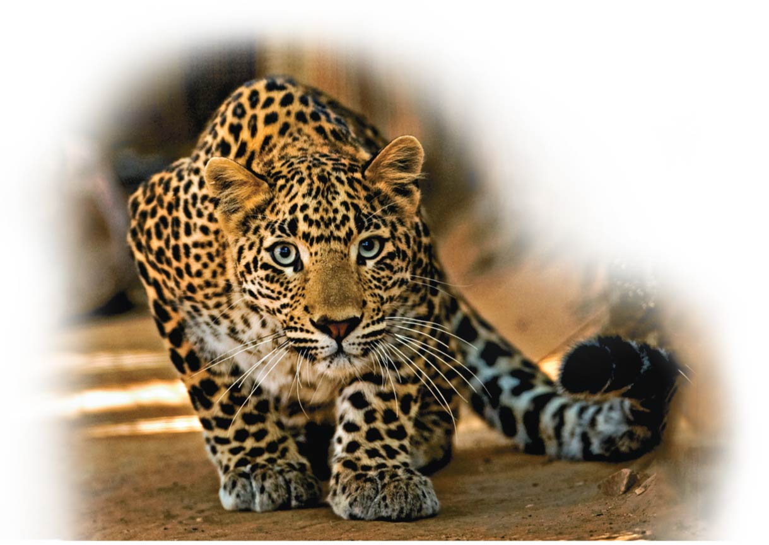
Introduction: Biology Today
Unit 1; Chapter 1

Slide 8
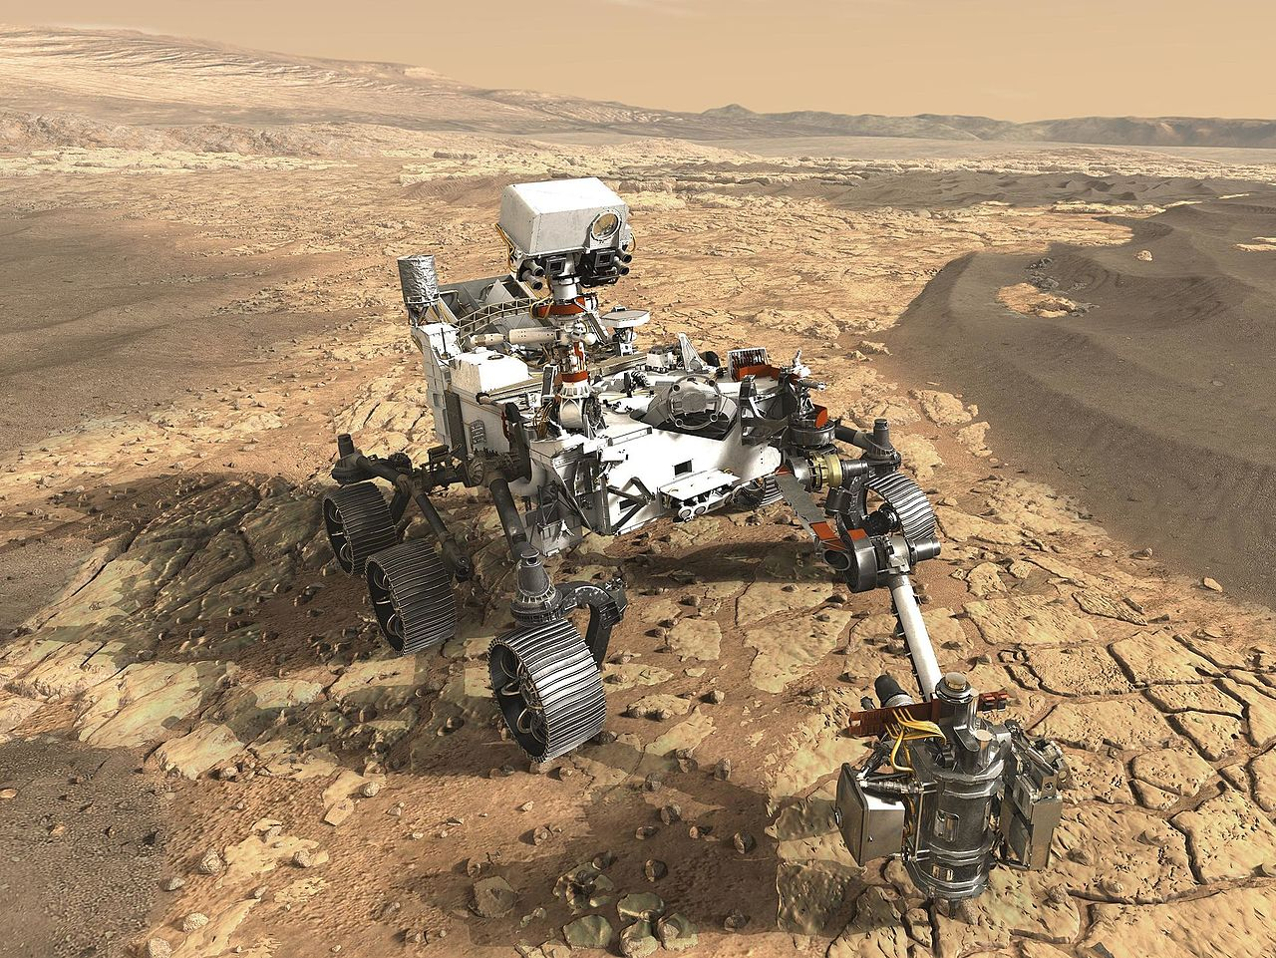

We have an inborn curiosity about life …
Mars 2020
One of the primary missions of the Mars rover is to search for signs of life.

Slide 9
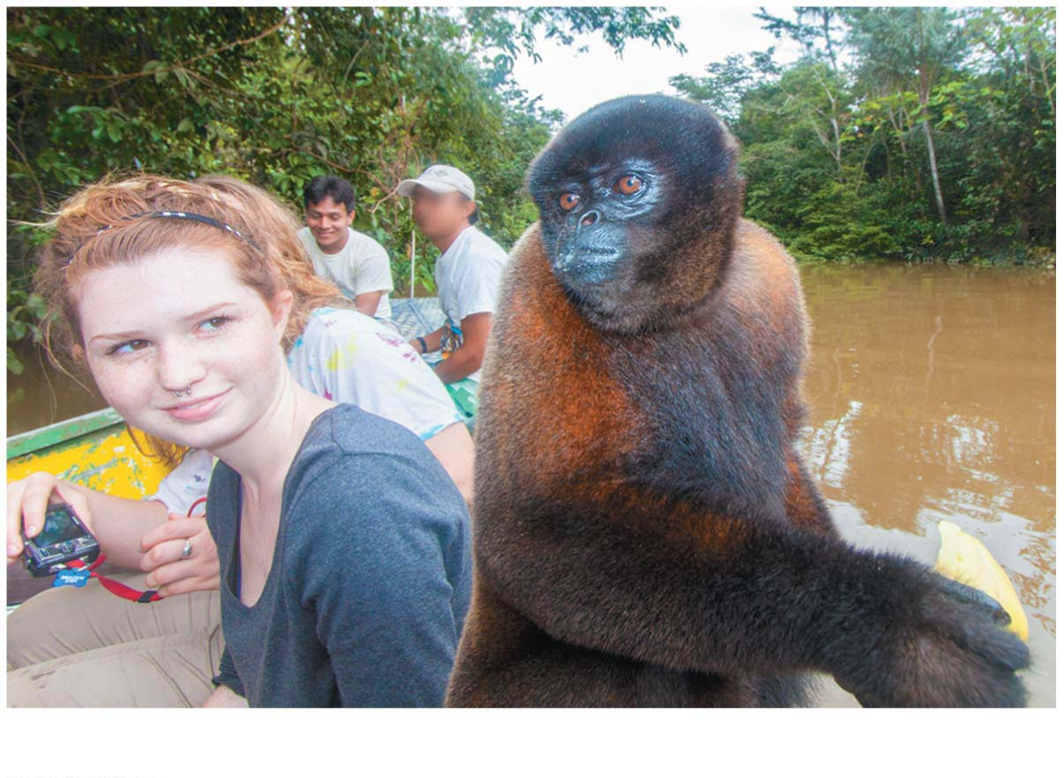
Biology is all around us …
Notes:
Figure 1.0-2 Biology all around us: an inborn curiosity about nature

Slide 10
The Scientific Study of Life
Biology is the scientific study of life.
Bio- life or living things
Logy – Logie, a scientific study
Here the questions are:
What is a scientific study?
What does it mean to be alive?
Notes:
10

Slide 11
The Process of Science
How do we tell the difference between science and other ways of trying to make sense of nature?
Science is an approach to understanding the natural world that is based on inquiry:
a search for information,
explanations, and
answers to specific questions.
Notes:
11

Slide 12
The Process of Science
Human beings understand our natural world through using two basic scientific approaches:
discovery science, which is mostly about describing nature, and
hypothesis-driven science, which is mostly about explaining nature.
Most scientists practice a combination of these two forms of inquiry.
Notes:
12

Slide 13
知其然而不知其所以然
知其然 而 知其所以然
Discovery
Science
“What”
Hypothesis-Driven
Science
“Why”

Slide 14
Discovery Science (“Descriptive Science”)
Science seeks natural causes for natural phenomena.
This limits the scope of science to the study of structures and processes that we can
verifiably observe, and
measure directly or indirectly with the help of tools and technology, such as microscopes.
Notes:
14

Slide 15
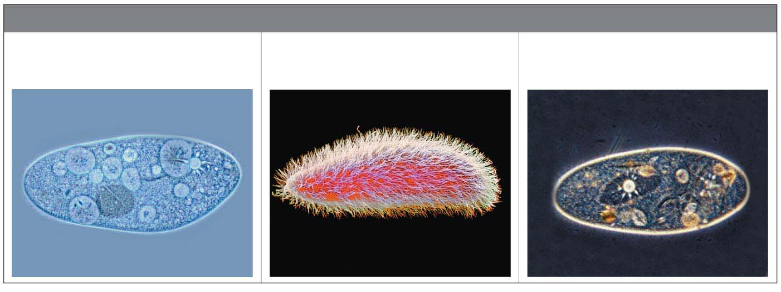
Discovery Science:
Making Careful Observation
Paramecium
TYPES OF MICROGRAPHS
Scanning Electron
Micrograph (SEM)
Transmission Electron
Micrograph (TEM)
Light Micrograph (LM)
光学显微镜图
扫描电子显微镜图
透射电子显微镜图
Microscope: 显微镜 Micrograph: 显微镜图

Slide 16
Discovery Science
Recorded observations are called data （数据）, all scientific inquiry is based on data.
Scientific data must be verifiable and repeatable.
Notes:
16

Slide 17
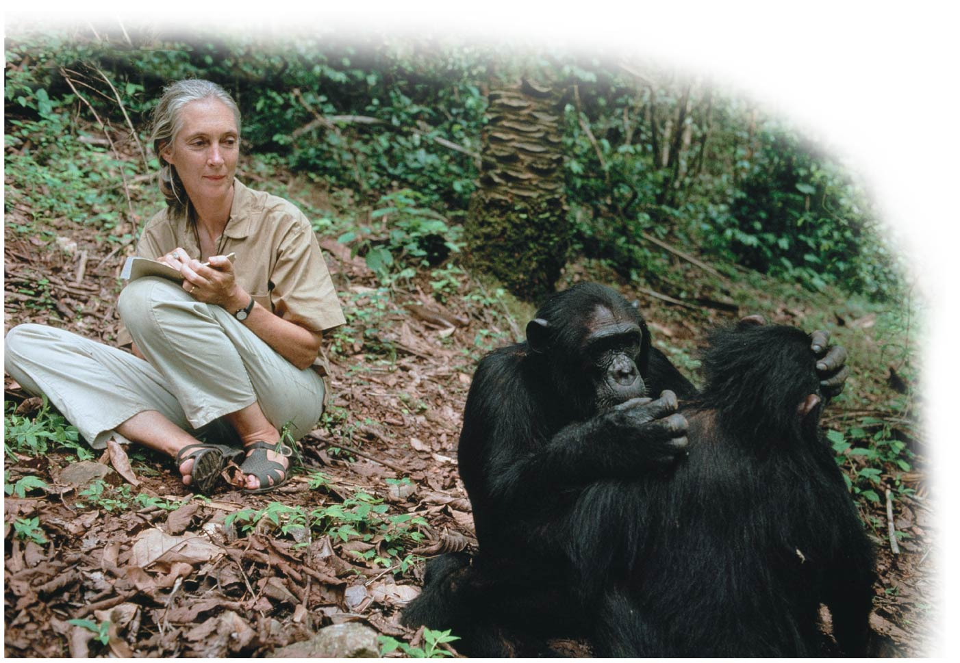
Discovery Science: Making Careful Observation
Notes:
Figure 1.2-1 Careful observation and measurement: the raw data for discovery science (part 1: Goodall and chimp)

Slide 18
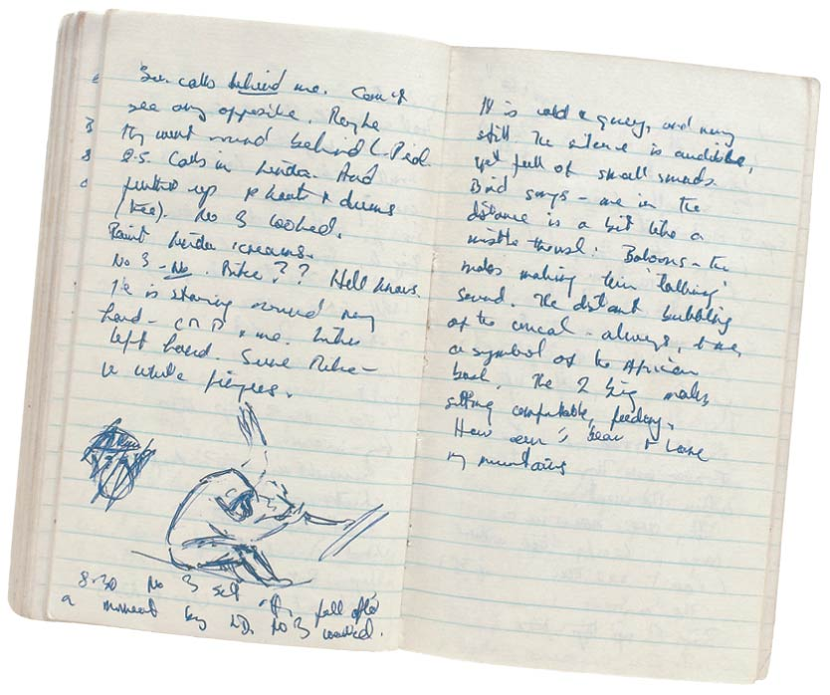
Discovery Science: Making Careful Observation
Notes:
Figure 1.2-2 Careful observation and measurement: the raw data for discovery science (part 2: Goodall's notebook)

Slide 19
Hypothesis-Driven Science
The observations of discovery science motivate us to ask questions and seek explanations.
As a formal process of inquiry, the scientific method consists of a series of steps that provide a loose guideline for scientific investigations.
Notes:
19

Slide 20
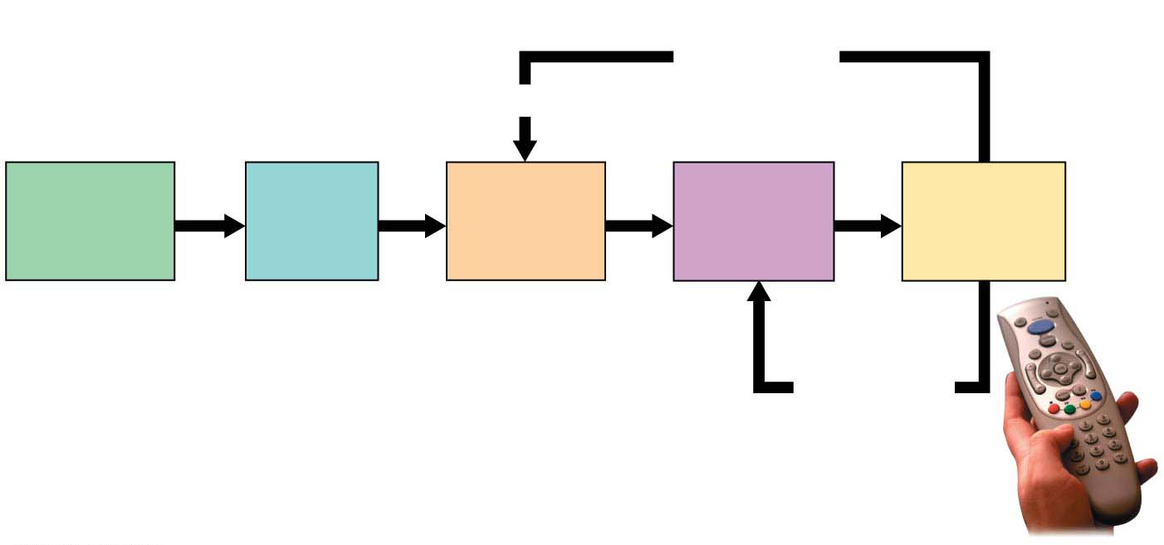
Hypothesis-Driven Science
Experiment
does not
support
hypothesis.
Revise.
Observation
The remote
doesn’t
work.
Question
What’s
wrong?
Hypothesis
The
batteries
are dead.
Prediction
With new
batteries, it
will work.
Experiment
Replace
batteries.
Experiment
supports
hypothesis;
make more
predictions
and test.
Notes:
Figure 1.3-s5 Applying the scientific method to a common problem (step 5)

Slide 21
Hypothesis-Driven Science
Most modern scientific investigations can be described as hypothesis-driven science.
A hypothesis is
a tentative answer to a question or
a proposed explanation for a set of observations.
A good hypothesis immediately leads to predictions that can be tested by experiments.
Notes:
21

Slide 22
Hypothesis-Driven Science
Once a hypothesis is formed, an investigator can make predictions about what results are expected if that hypothesis is correct.
We then test the hypothesis by performing an experiment to see whether or not the results are as predicted.
Notes:
22

Slide 23
Theories in Science
Accumulating facts is not the primary goal of science.
What really advances science are new theories that tie together a number of observations that previously seemed unrelated.
The cornerstones of science are the explanations that apply to the greatest variety of phenomena.
People like Isaac Newton, Charles Darwin, and Albert Einstein stand out in the history of science not because they discovered a great many facts but because their theories had such broad explanatory power.
Notes:
23

Slide 24
Theories in Science
What is a scientific theory, and how is it different from a hypothesis?
A scientific theory is much broader in scope than a hypothesis.
A theory
is a comprehensive explanation supported by abundant evidence, and
is general enough to spin off many new testable hypotheses.
Notes:
24

Slide 25
Theories in Science
For example, these are two hypotheses.
“White fur is an adaptation that helps polar bears survive in an Arctic habitat.”
“The unusual bone structure in a hummingbird’s wings is an evolutionary adaptation that provides an advantage in gathering nectar from flowers.”
In contrast, the following theory ties together those seemingly unrelated hypotheses:
“Adaptations to the local environment evolve by natural selection.”
Notes:
25
their white coloring helps them blend in with their icy surroundings.

Slide 26
Theories in Science
Theories only become widely accepted by scientists if they
are supported by extensive evidence, and
have not been contradicted by any scientific data.
Notes:
26

Slide 27
The Nature of Life
What is life?
What distinguishes living things from nonliving things?
The phenomenon of life seems to defy a simple, one-sentence definition.
We recognize life mainly by what living things do.
Notes:
27

Slide 28
The Properties of Life
Order
Regulation
Growth and development
Energy processing
Response to environment
Reproduction
Evolution
Notes:
28

Slide 29
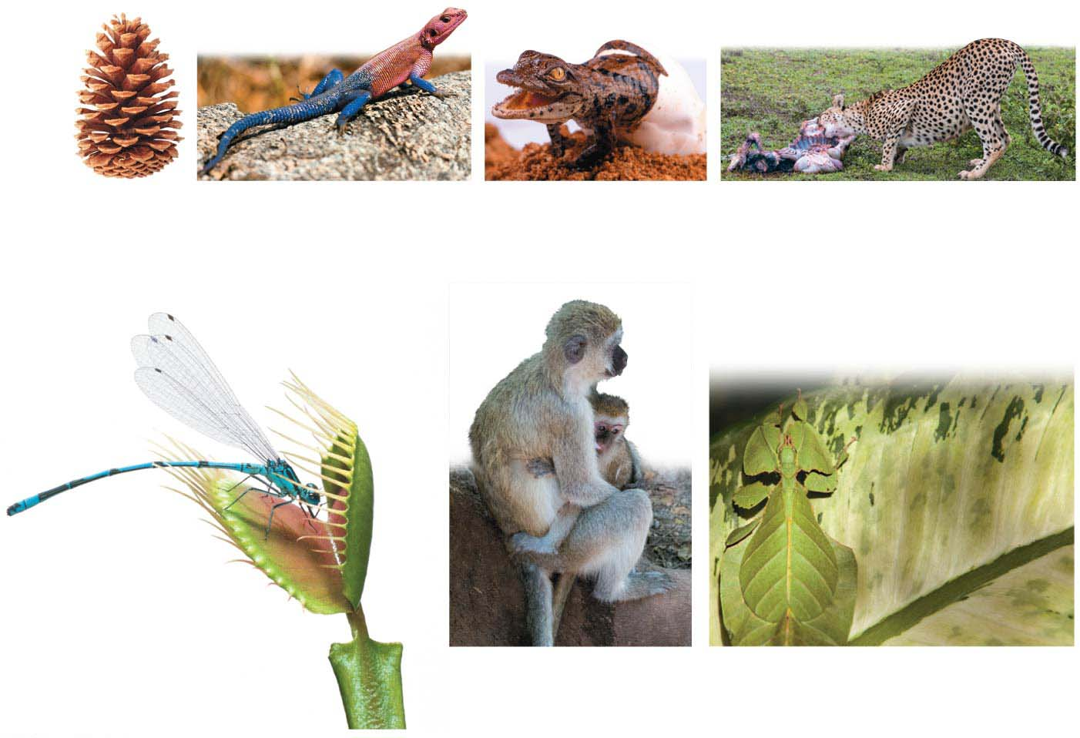
Order
Regulation
Growth and
development
Energy processing
Response to
the environment
Reproduction
Evolution
Venus flytrap
Notes:
Figure 1.UN02 Summary of key concepts: properties of life

Slide 30
Life in Its Diverse Forms
Biologists add thousands of newly identified species to the list each year.
Estimates of the total number of species (种系） range from 10 million to more than 100 million.
Notes:
30

Slide 31
Grouping Species: The Basic Concept
A species (种系）is generally defined as a group of organisms that
have the potential to interbreed with one another in nature to produce healthy offspring.
Taxonomy（分类学）, is a branch of biology that names and classifies species, and is the arrangement of species into a hierarchy（等级） of broader and broader groups.
Notes:
31

Slide 32
The Three Domains of Life
The three domains of life are
Bacteria （细菌）
Archaea （古细菌）
Eukarya （真核生物界）
Bacteria and Archaea have prokaryotic cells （原核细胞）. Pro – before; Karyon- nut, kernel
Eukarya have eukaryotic cells（真核细胞）. Eu- real, true; karyon- nut, kernel
Notes:
32

Slide 33
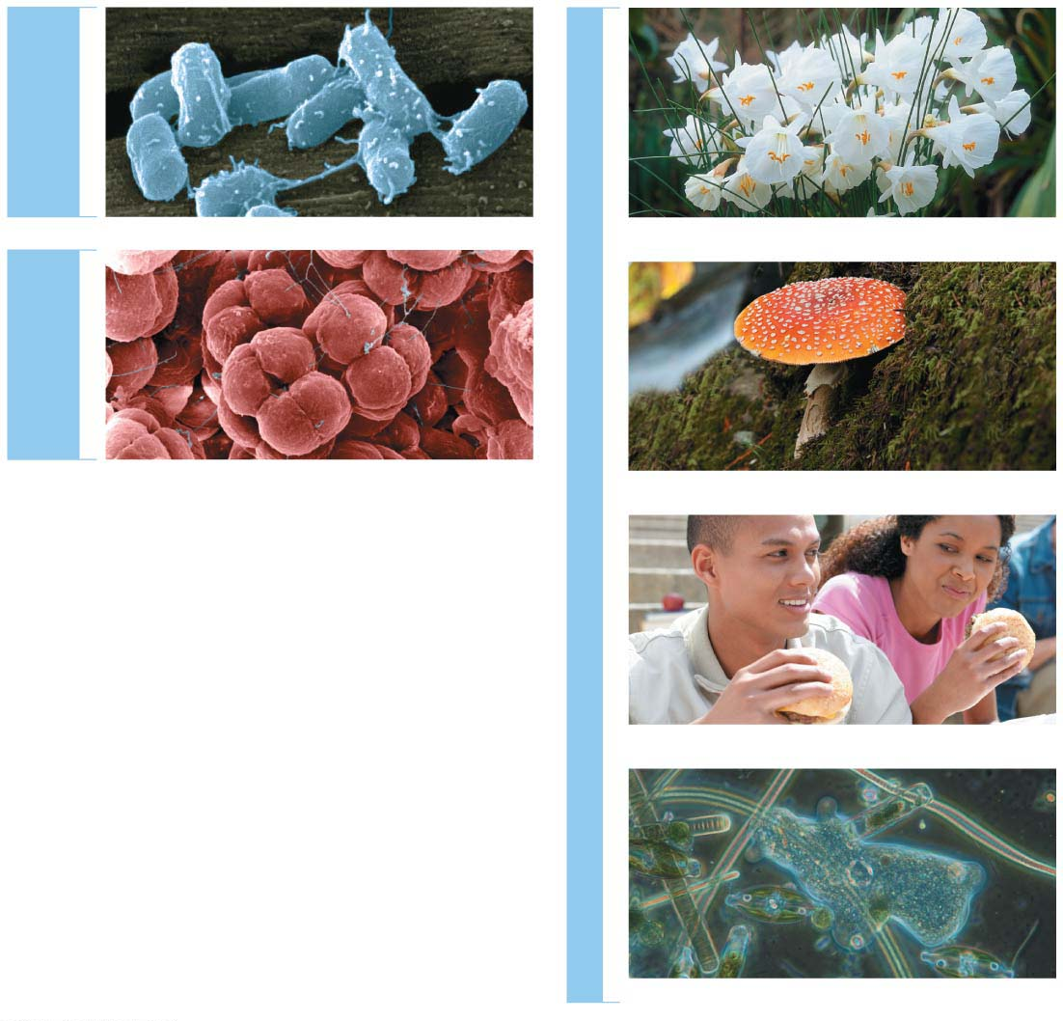
Figure 1.7
细菌
DOMAIN
BACTERIA
Kingdom Plantae（植物界）
古细菌
DOMAIN
ARCHAEA
DOMAIN EUKARYA
Kingdom Fungi（真菌界）
Kingdom Animalia（动物界）
Protists（原生生物）(multiple kingdoms)
Notes:
Figure 1.7 The three domains of life

Slide 34
The Three Domains of Life
The Domain Eukarya in turn includes three smaller divisions called kingdoms:
Kingdom Plantae,
Kingdom Fungi, and
Kingdom Animalia.
Most members of the three kingdoms are multicellular.
Notes:
34

Slide 35
The Three Domains of Life
These three multicellular kingdoms are distinguished partly by how the organisms obtain food.
Plants produce their own sugars and other foods by photosynthesis.
Fungi are mostly decomposers, digesting（消化）dead organisms and organic wastes.
Animals obtain food by ingesting (eating) and digesting other organisms.
Notes:
35

Slide 36
The Three Domains of Life
Those eukaryotes that do not fit into any of the three kingdoms fall into a catch-all group called the protists（原生生物）.
Most protists are single-celled; they include microscopic organisms such as amoebas（变形虫（单细胞生物））.
But protists also include certain multicellular forms, such as seaweeds.
Scientists are in the process of organizing protists into multiple kingdoms, although they do not yet agree on exactly how to do this.
Notes:
36

Slide 37
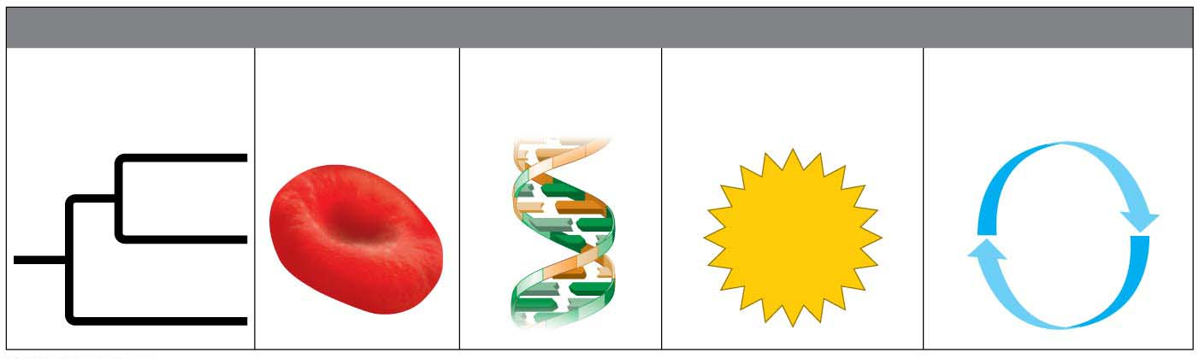
Major Themes in Biology
The following five unifying themes will serve as touchstones throughout our investigation of biology.
MAJOR THEMES IN BIOLOGY
Structure/
Function
Information
Flow
Energy
Transformations
Interconnections
within Systems
Evolution
Notes:
Figure 1.8 Five unifying themes that run throughout the discipline of biology

Slide 38
Evolution
Evolution is
the fundamental principle of life and
the core theme that unifies all of biology.
The theory of evolution by natural selection, first described by Charles Darwin more than 150 years ago, is the one idea that makes sense of everything we know about living organisms.
Notes:
38

Slide 39
Evolution
Life evolves.
Each species is one twig of a branching tree of life extending back in time through ancestral species more and more remote.
Species that are very similar, such as the brown bear and polar bear, share a more recent common ancestor that represents a relatively recent branch point on the tree of life.
Notes:
39

Slide 40
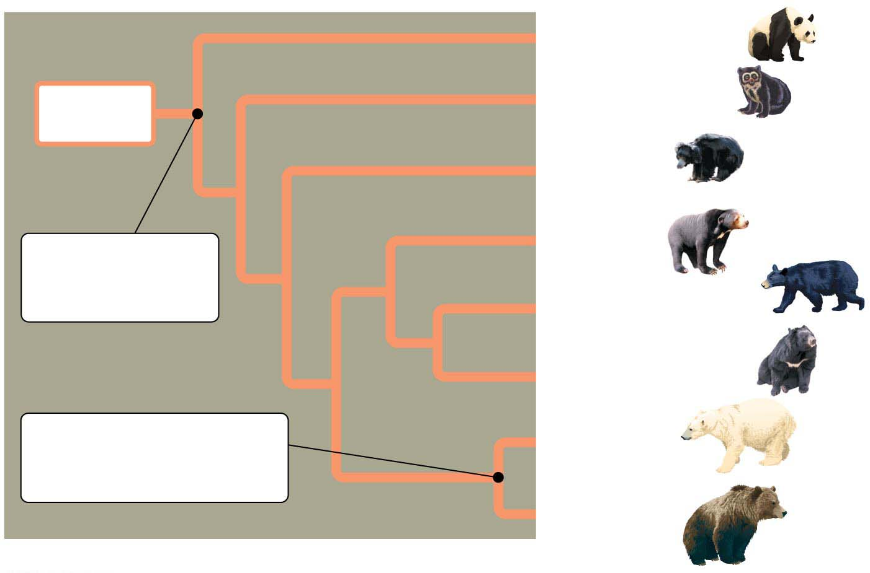
Figure 1.9
Giant panda bear
（祖先的）
Ancestral
bear
Spectacled bear
（眼镜熊）
Sloth bear
（印度懒熊）
Sun bear
Common
ancestor of all
modern bears
American black bear
Asiatic black bear
Common
ancestor of polar bear
and brown bear
Polar bear
Brown bear
Notes:
Figure 1.9 An evolutionary tree of bears

Slide 41
The Darwinian View of Life
The evolutionary view of life came into focus in 1859 when Charles Darwin published On the Origin of Species by Means of Natural Selection.
Notes:
41

Slide 42
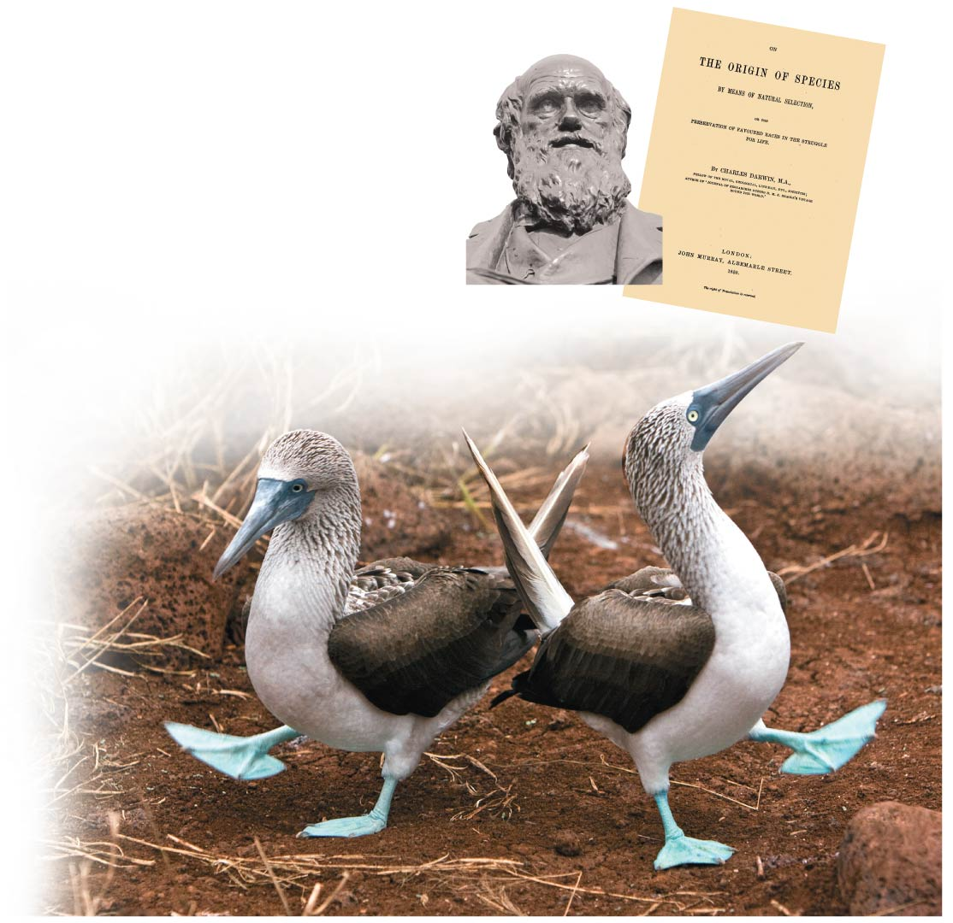
Notes:
Figure 1.10 Charles Darwin (1809–1882), The Origin of Species, and blue-footed boobies he observed on the Galápagos Islands

Slide 43
The Darwinian View of Life
Darwin’s book developed two main points:
Species living today descended from a succession of ancestral species in what Darwin called “descent with modification,” capturing the duality of life’s
unity (descent) and
diversity (modification).
Natural selection is the mechanism for descent with modification.
Notes:
43

Slide 44
The Darwinian View of Life
In the struggle for existence, those individuals with heritable traits best suited to the local environment are more likely to survive and leave the greatest number of healthy offspring.
Survival
Reproductive Success
Notes:
44

Slide 45
The Darwinian View of Life
Therefore, these passed-down traits that enhance survival and reproductive success will be represented in greater numbers the next generation.
It is this unequal reproductive success that Darwin called natural selection because the environment “selects” only certain heritable traits from those already existing.
The product of natural selection is adaptation, the accumulation of variations in a population over time.
Notes:
45

Slide 46
The Darwinian View of Life
We now recognize many examples of natural selection in action.
A classic example involves the finches (a kind of bird) of the Galápagos Islands in Ecuador.
Notes:
46

Slide 47
The Darwinian View of Life
Over two decades, researchers measured changes in beak size in a population of a species of ground finch that eats mostly small seeds.
In dry years, when the preferred small seeds are in short supply, the birds must eat large seeds.
Birds with larger, stronger beaks have a feeding advantage and greater reproductive success, and the average beak depth for the population increases.
Notes:
47

Slide 48
The Darwinian View of Life
Antibiotic resistance（抗生素抗性）in bacteria evolves in response to the overuse of antibiotics when dairy and cattle farmers add antibiotics to feed.
The members of the bacteria population will, through random chance, vary in their susceptibility（敏感性）to the antibiotic.
Once the environment changes by the addition of antibiotics,
some bacteria will succumb quickly and die,
while others will tend to survive.
Notes:
48

Slide 49
The Darwinian View of Life
Those bacteria that survive will multiply, producing offspring that will likely inherit the traits that enhance survival.
Over many bacterial generations, feeding antibiotics to cows may promote the evolution of antibiotic-resistant bacteria that, if transferred to the human food supply, could cause infections that are not susceptible to standard drug treatments.
Notes:
49

Slide 50
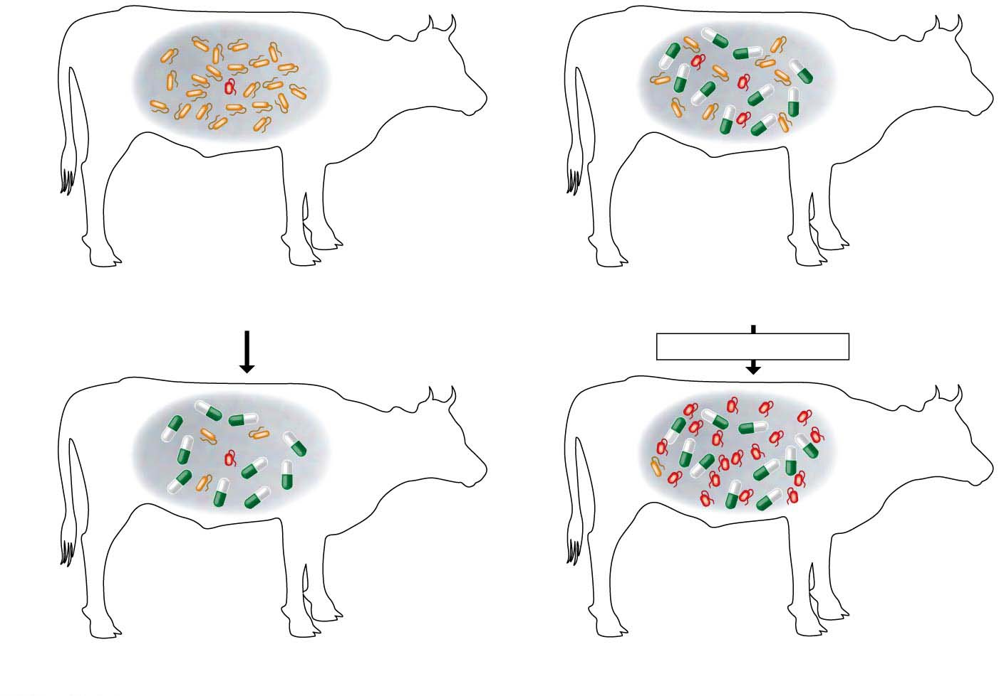
Figure 1.12
Bacterium（细菌）with
antibiotic
resistance
Bacteria
Population with varied inherited traits
Reproduction of survivors
Antibiotic
added
Many generations
Elimination of individuals with certain traits
Increasing frequency of traits that enhance
survival and reproductive success
Notes:
Figure 1.12 Natural selection in action

Slide 51
Observing Artificial Selection
Artificial selection（人工选择）is the purposeful breeding of domesticated（家养的） plants and animals by humans.
Humans have customized crop plants through many generations of artificial selection by selecting different parts of the plant to accentuate as food.
Domestication; Domesticated（家养）
Notes:
51

Slide 52
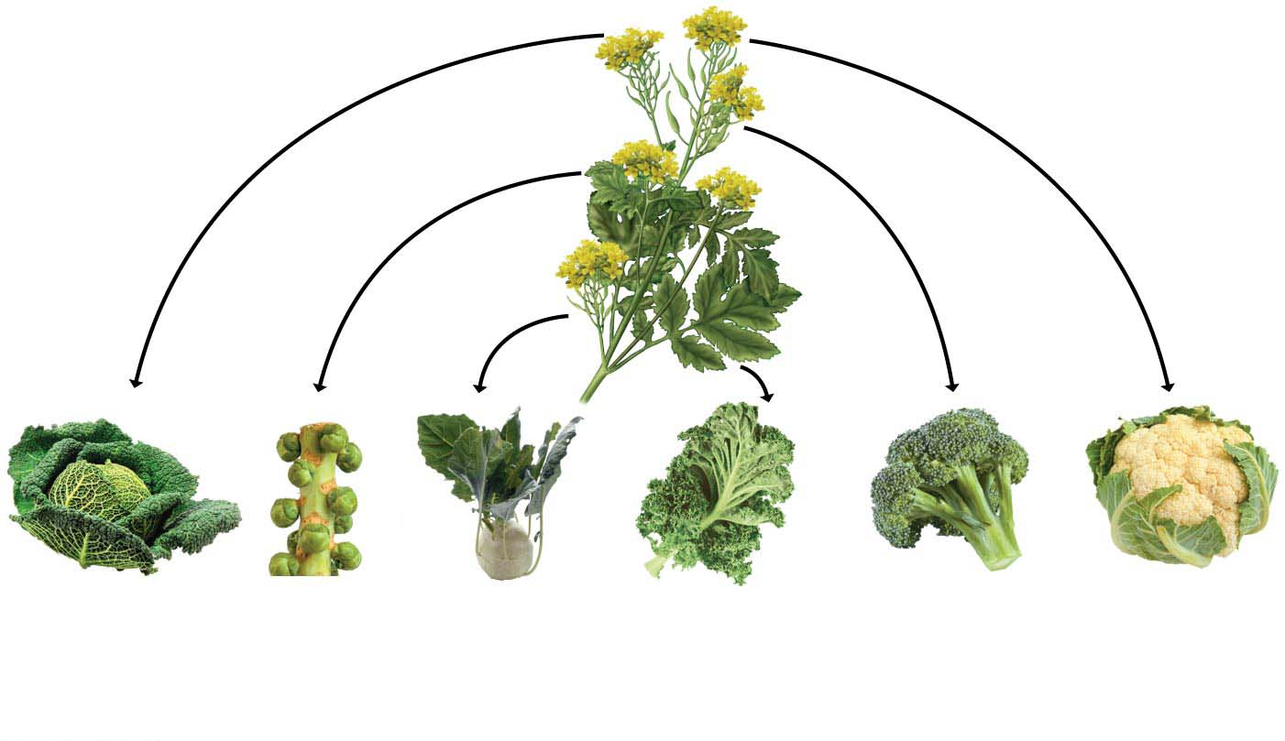
Observing Artificial Selection
Wild
mustard
（田芥菜）
Cabbage
（卷心菜）from end buds（芽）
Brussels
Sprouts
（球芽甘蓝）
from side
buds
Kohlrabi
（甘蓝）from
Stems
（茎）
Kale
（羽衣甘蓝）from
leaves
Broccoli
（西兰花）
from flowers
and stems
Cauliflower
（菜花）
from flower
clusters
Notes:
Figure 1.13 The artificial selection of food crops

Slide 53
Observing Artificial Selection
The power of selective breeding is also apparent in our pets, which have been bred for looks and usefulness.
For example, people in different cultures have customized hundreds of dog breeds as different as basset hounds（矮腿猎犬） and Saint Bernards（圣伯纳犬）, all descended from wolves.
Notes:
53

Slide 54
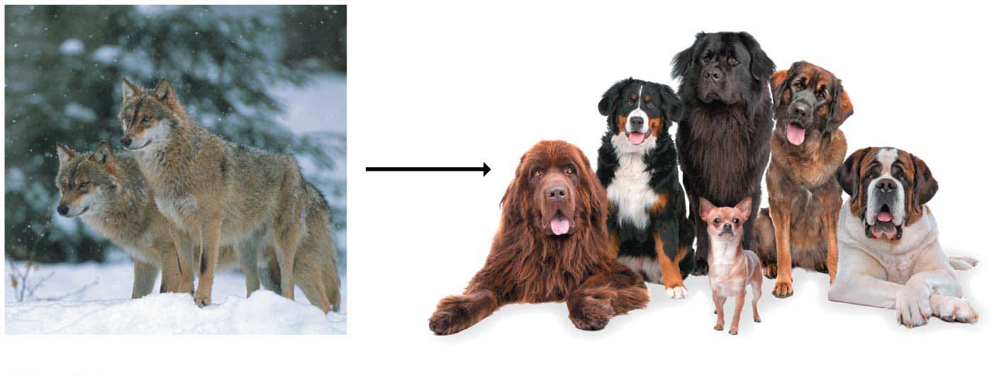
Observing Artificial Selection
Artificial
selection
Gray wolves
Domesticated dogs
Notes:
Figure 1.14 The artificial selection of pets

Slide 55
The Relationship of Structure to Function
Within biological systems, structure (the shape of something) and function (what it does) are often related, with each providing insight into the other.
Structure --- Anatomy
Function --- Physiology
Notes:
55

Slide 56
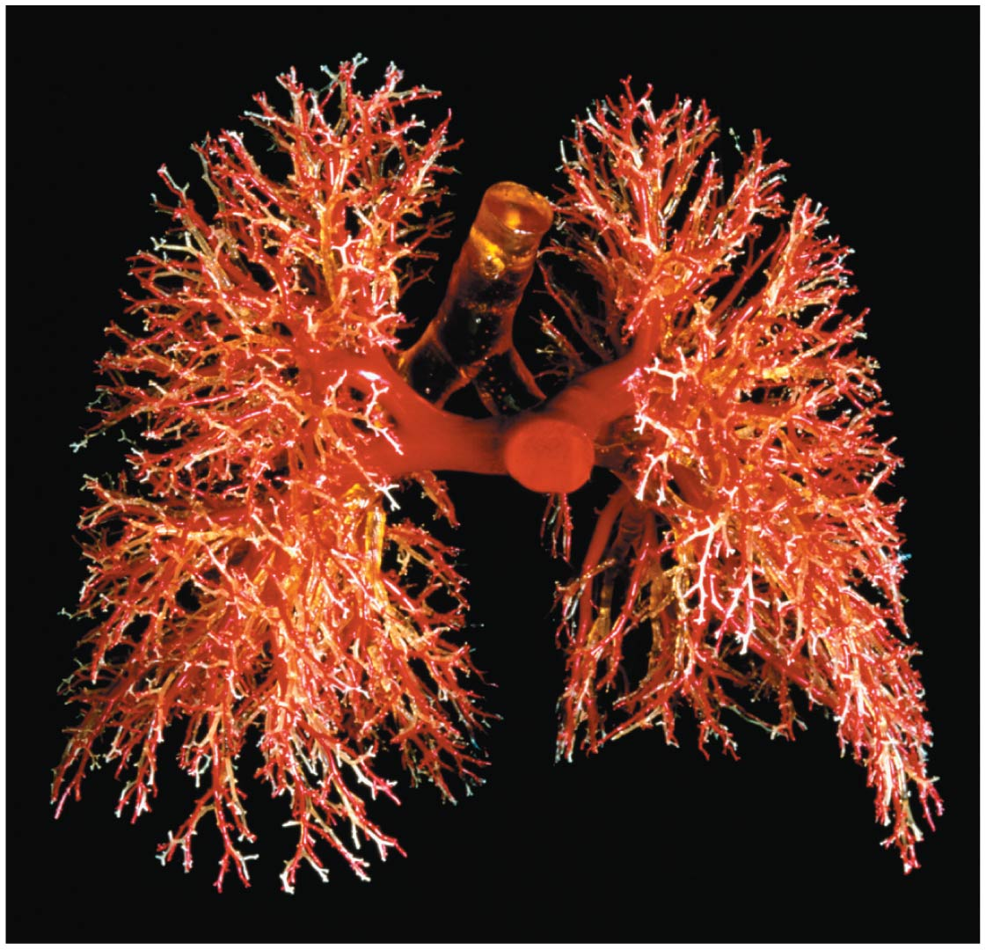

Slide 57
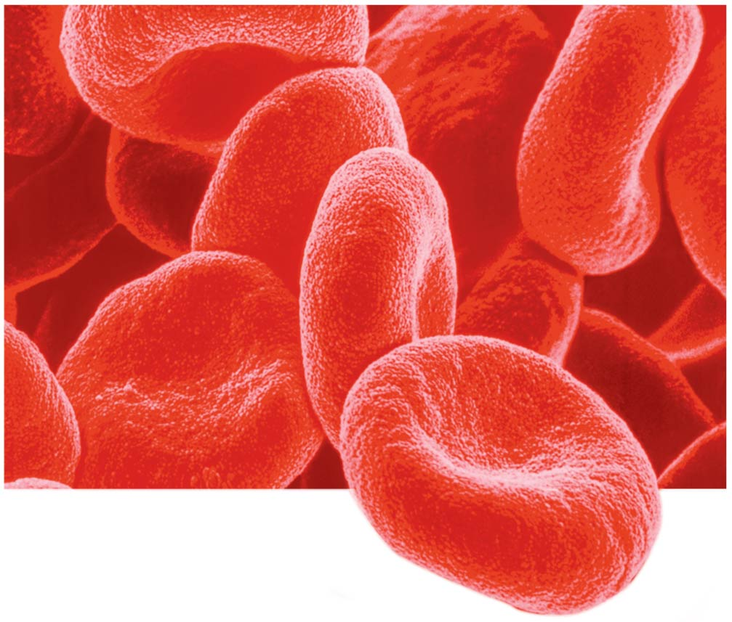
red blood cells
The concave indentation of red blood cells provides a large surface area through which oxygen can diffuse.
Notes:
Figure 1.16 Structure/function:

Slide 58
Information Flow
For life’s functions to proceed in an orderly manner, information must be
stored,
transmitted, and
used.
Notes:
58

Slide 59
Information Flow
All cells use DNA as the chemical material of genes, the units of inheritance（遗传） that transmit information from parent to offspring（后代）.
The language of life has an alphabet of just four letters.
The chemical names of DNA’s four molecular building blocks are abbreviated as A, G, C, and T.
Notes:
59

Slide 60
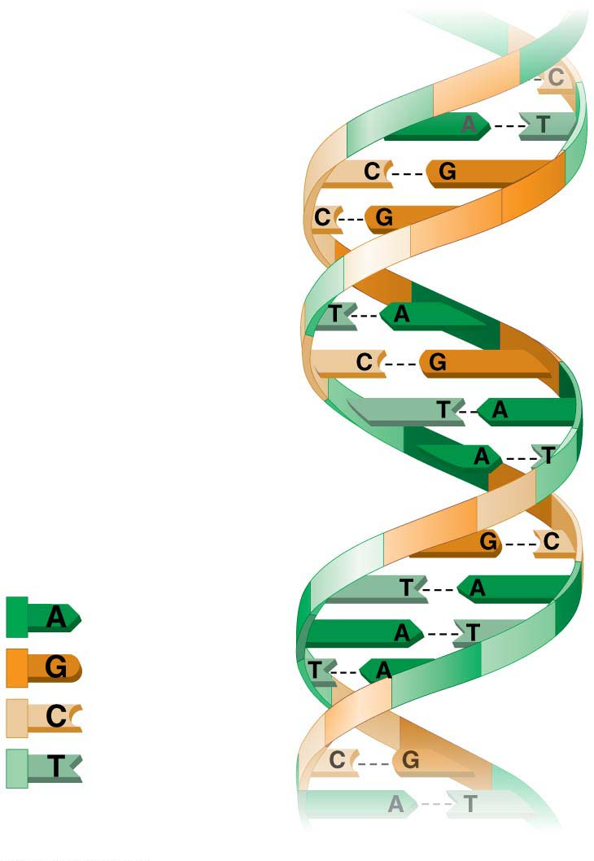
The four
chemical
building
blocks of
DNA
A DNA molecule
Notes:
Figure 1.17 The language of DNA

Slide 61
Energy Transformations: Pathways That Transform Energy and Matter
Various cellular activities of life are work, such as movement, growth, and reproduction, and work requires energy.
Life is made possible by
the input of energy, primarily from the sun, and
the transformation of energy from one form to another.
Notes:
61

Slide 62
Energy Transformations: Pathways That Transform Energy and Matter
Most ecosystems（生态系统）are solar powered.
Plants and other photosynthetic organisms（光合生物） (“producers”)
capture the energy that enters an ecosystem as sunlight and
convert it, storing it as chemical bonds within sugars and other complex molecules.
Notes:
62

Slide 63
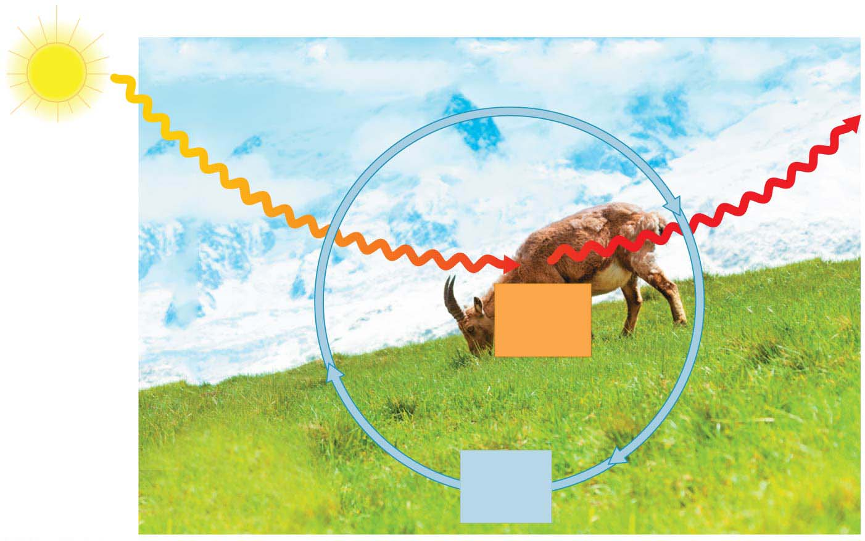
Inflow
of light
energy
ECOSYSTEM
Outflow
of heat
energy
Flow of energy
Consumers
(animals)
Chemical
energy
(food)
Producers
(plants and other
photosynthetic
organisms)
Decomposers
(in soil)
Cycling
of
nutrients
Notes:
Figure 1.19 Nutrient and energy flow in an ecosystem

Slide 64
Energy Transformations: Pathways That Transform Energy and Matter
Chemical energy is then passed through a series of “consumers” that break the bonds,
releasing the stored energy and
putting it to use.
Notes:
64

Slide 65
Energy Transformations: Pathways That Transform Energy and Matter
In the process of these energy conversions between and within organisms, some energy is converted to heat, which is then lost from the system.
Thus, energy flows through an ecosystem,
entering as light and
exiting as heat.
Notes:
65

Slide 66
Energy Transformations: Pathways that Transform Energy and Matter
Within all living cells, a vast network of interconnected chemical reactions are collectively referred to as metabolism（新陈代谢）, which continually converts energy from one form to another as matter is recycled.
Notes:
66

Slide 67
Interconnections within Biological Systems How life is studied at different scales?
The study of life extends
from the microscopic scale of the molecules and cells that make up organisms
to the global scale of the entire living planet.
Notes:
67

Slide 68
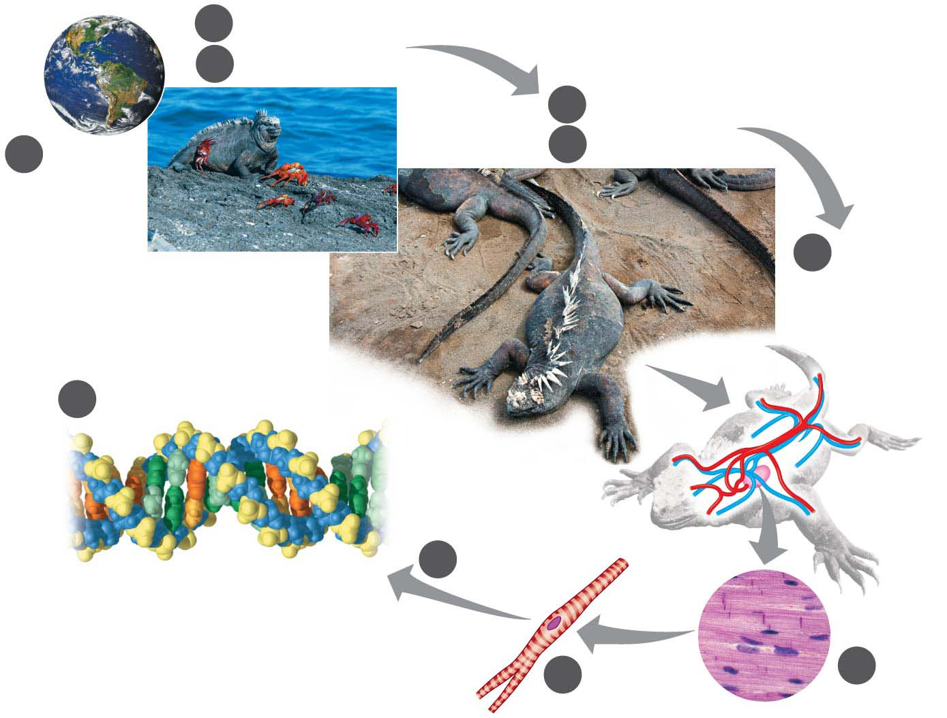
2
Ecosystems
3
Communities
4
Populations
1
5
Organisms
Biosphere
6
Organ
Systems
and
Organs
10
Molecules and Atoms
9
Organelles
Atom
Nucleus
8
Cells
7
Tissues
Notes:
Figure 1.20-s3 Zooming in on life (step 3)

Slide 69
Interconnections within Biological Systems
Biologists are investigating life at its many levels,
from the interactions within the biosphere
to the molecular machinery within cells.
Notes:
69

